Slide 1
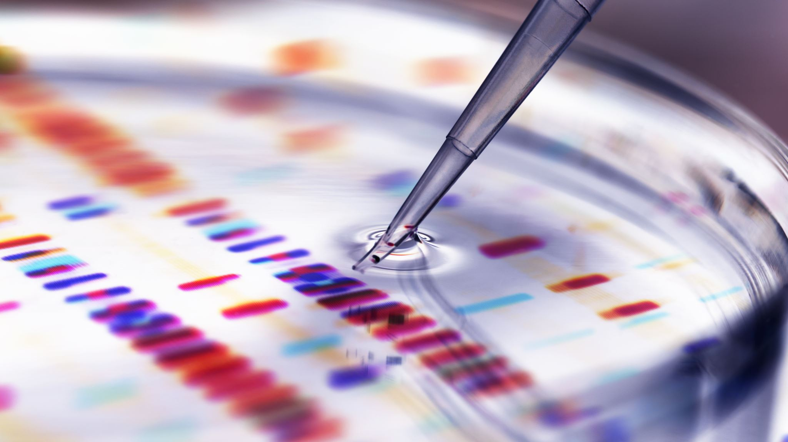
Plagiarism Detection and Paraphrase based on Gen AI
Rahul Birwadkar(11037364)
M.E. in Information Technology

Slide 2
Thesis Objectives:
Detect plagiarism using AI to compare text with existing content and identify copied material.
Paraphrase content using AI-based models to rewrite text while preserving its original meaning.

Slide 3
Plagiarism Detection Approach:
Dataset Selection:
PAN Dataset 2011
Pre- Train (all-MiniLM-l6-v2)
Fine- Tune MiniLM model
Direct Fine Tune
Sentence Transformer Based

Slide 4
Paraphrase Generation Approach:
Dataset Selection:
PAWS (Paraphrase Adversaries from Word Scrambling)
Pre- Train BART Model
Fine- Tune BART model
DeepSeek Model

Slide 5
Plagiarism Detection Result
Model | Approach | Accuracy | Precision | Recall | F1 Score | False Positives | False Negatives
Pre-Trained (T=0.4) | Pre-trained embeddings + Cosine Similarity | 0.8825 | 0.9961 | 0.7678 | 0.8672 | 3 | 232
Pre-Trained (T=0.8) | Pre-trained embeddings + Cosine Similarity | 0.501 | 1 | 0.001 | 0.002 | 0 | 998
Sentence Transformer-based (T=0.4) | Fine-tuned embeddings + Cosine Similarity | 0.494 | 0.493 | 0.4605 | 0.4762 | 473 | 539
Sentence Transformer-based (T=0.8) | Fine-tuned embeddings + Cosine Similarity | 0.5005 | 1 | 0 | 0 | 0 | 999
Direct Fine-Tune model (T=0.4) | Fine-tuned MiniLM model Cosine Similarity | 0.761 | 0.6776 | 0.995 | 0.8062 | 473 | 5
Direct Fine-Tune model (T=0.8) | Fine-tuned MiniLM model Cosine Similarity | 0.6355 | 0.9355 | 0.2903 | 0.4431 | 20 | 709

Slide 6
Paraphrase Generation Result
Models | Mean Similarity Score | Mean BLEU Score | Mean ROUGE-1 Score | Mean ROUGE-2 Score | Mean ROUGE-L Score
Pre-Trained BART | 0.568544851 | 0.1521653 | 0.296478498 | 0.271408999 | 0.2964785
DeepSeek | 0.484291759 | 0.1449606 | 0.300191897 | 0.275761999 | 0.3001919
Fine-Tuned BART | 0.855780053 | 0.4097691 | 0.897234577 | 0.748237609 | 0.8349462

Slide 7
Web scraping Approach:
Website | Nature of Content
GeeksforGeeks | Programming & algorithm tutorials
W3Schools | Web development & coding guides
TutorialsPoint | General education & technical writing
Programiz | Python & Java tutorials
Real Python | Python-focused coding articles
JavaTpoint | Software engineering & Java concepts
FreeCodeCamp | Coding lessons & open-source projects

Slide 8
Challenges and Solutions
Dataset Labelling
Require Large Computational
Extract XML for Natural Labels
Google Colab A100 GPU

Slide 9

Thank You

